Slide 1
20220419
Tianlong Zhou

Slide 2
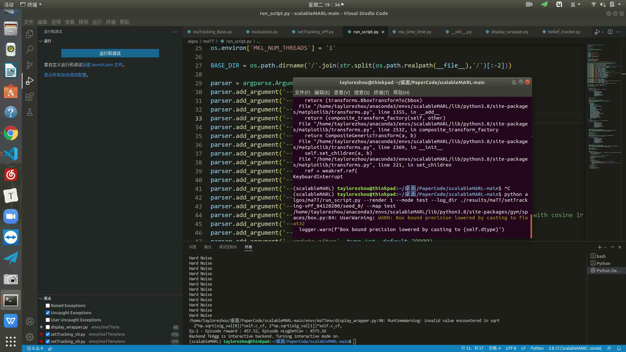
栅格化&多单位
3min, agents are blocked by the wall.

